Slide 1
Importing and Visualising a Cube using Hierarchies and Tableau

Slide 2
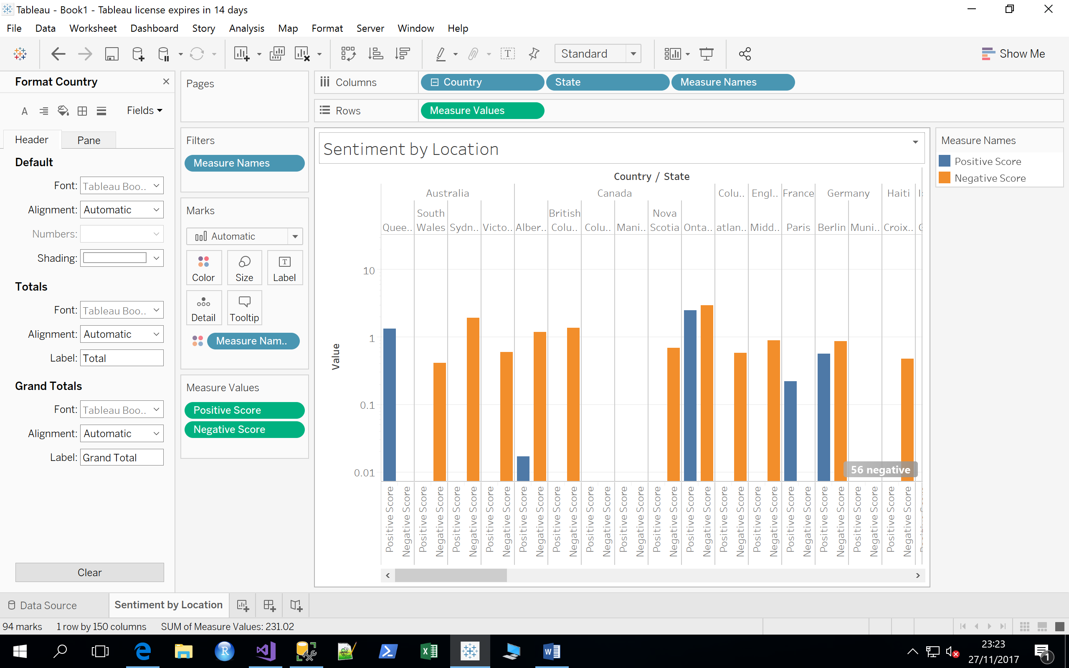
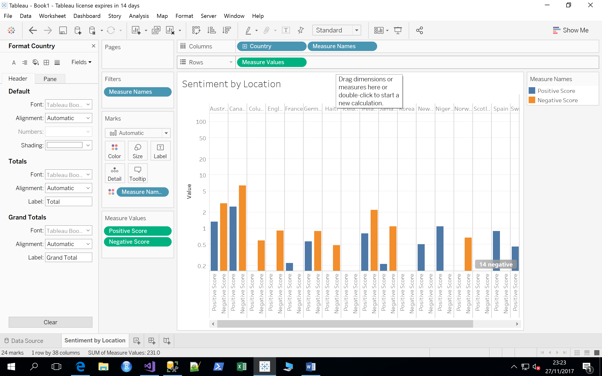
Introduction
This is not an exhaustive introduction. Instead, it aims to show the following things:
Building a simple hierarchy
Importing a cube into Tableau
Making a drillable Visualisation
By Country
By Country/State

Slide 3
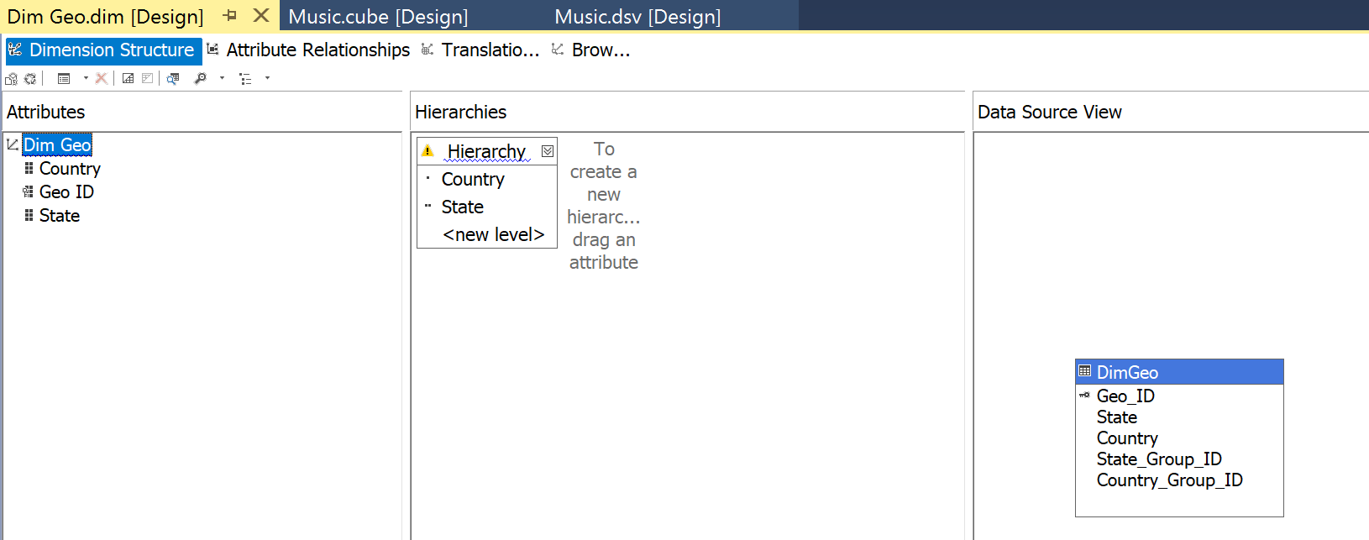
Making a Hierarchy: Using the Music Example
We’re going to engineer the DimGeo dimension; we have State, and Country – a natural hierarchy
Go to your SSAS mutlidimensional project, and double click the DimGeo dimension. It will open a designer view.
Then Drag country and state from right to left, such that they become attributes.
Then, insert them into the hierarchy as shown

Slide 4
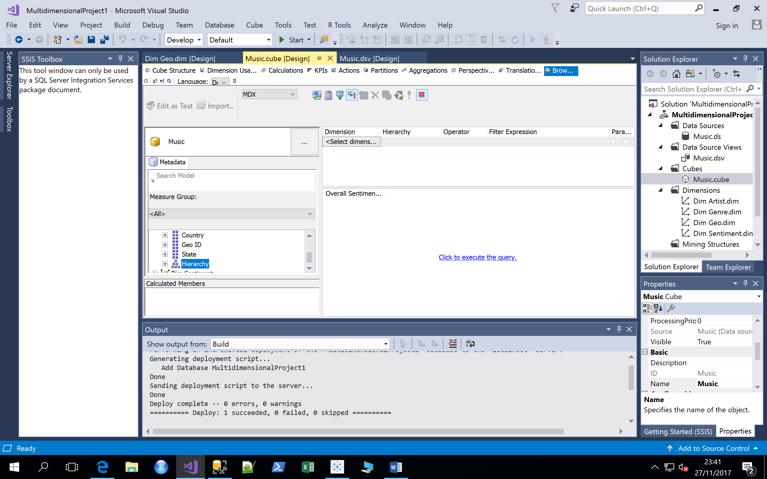
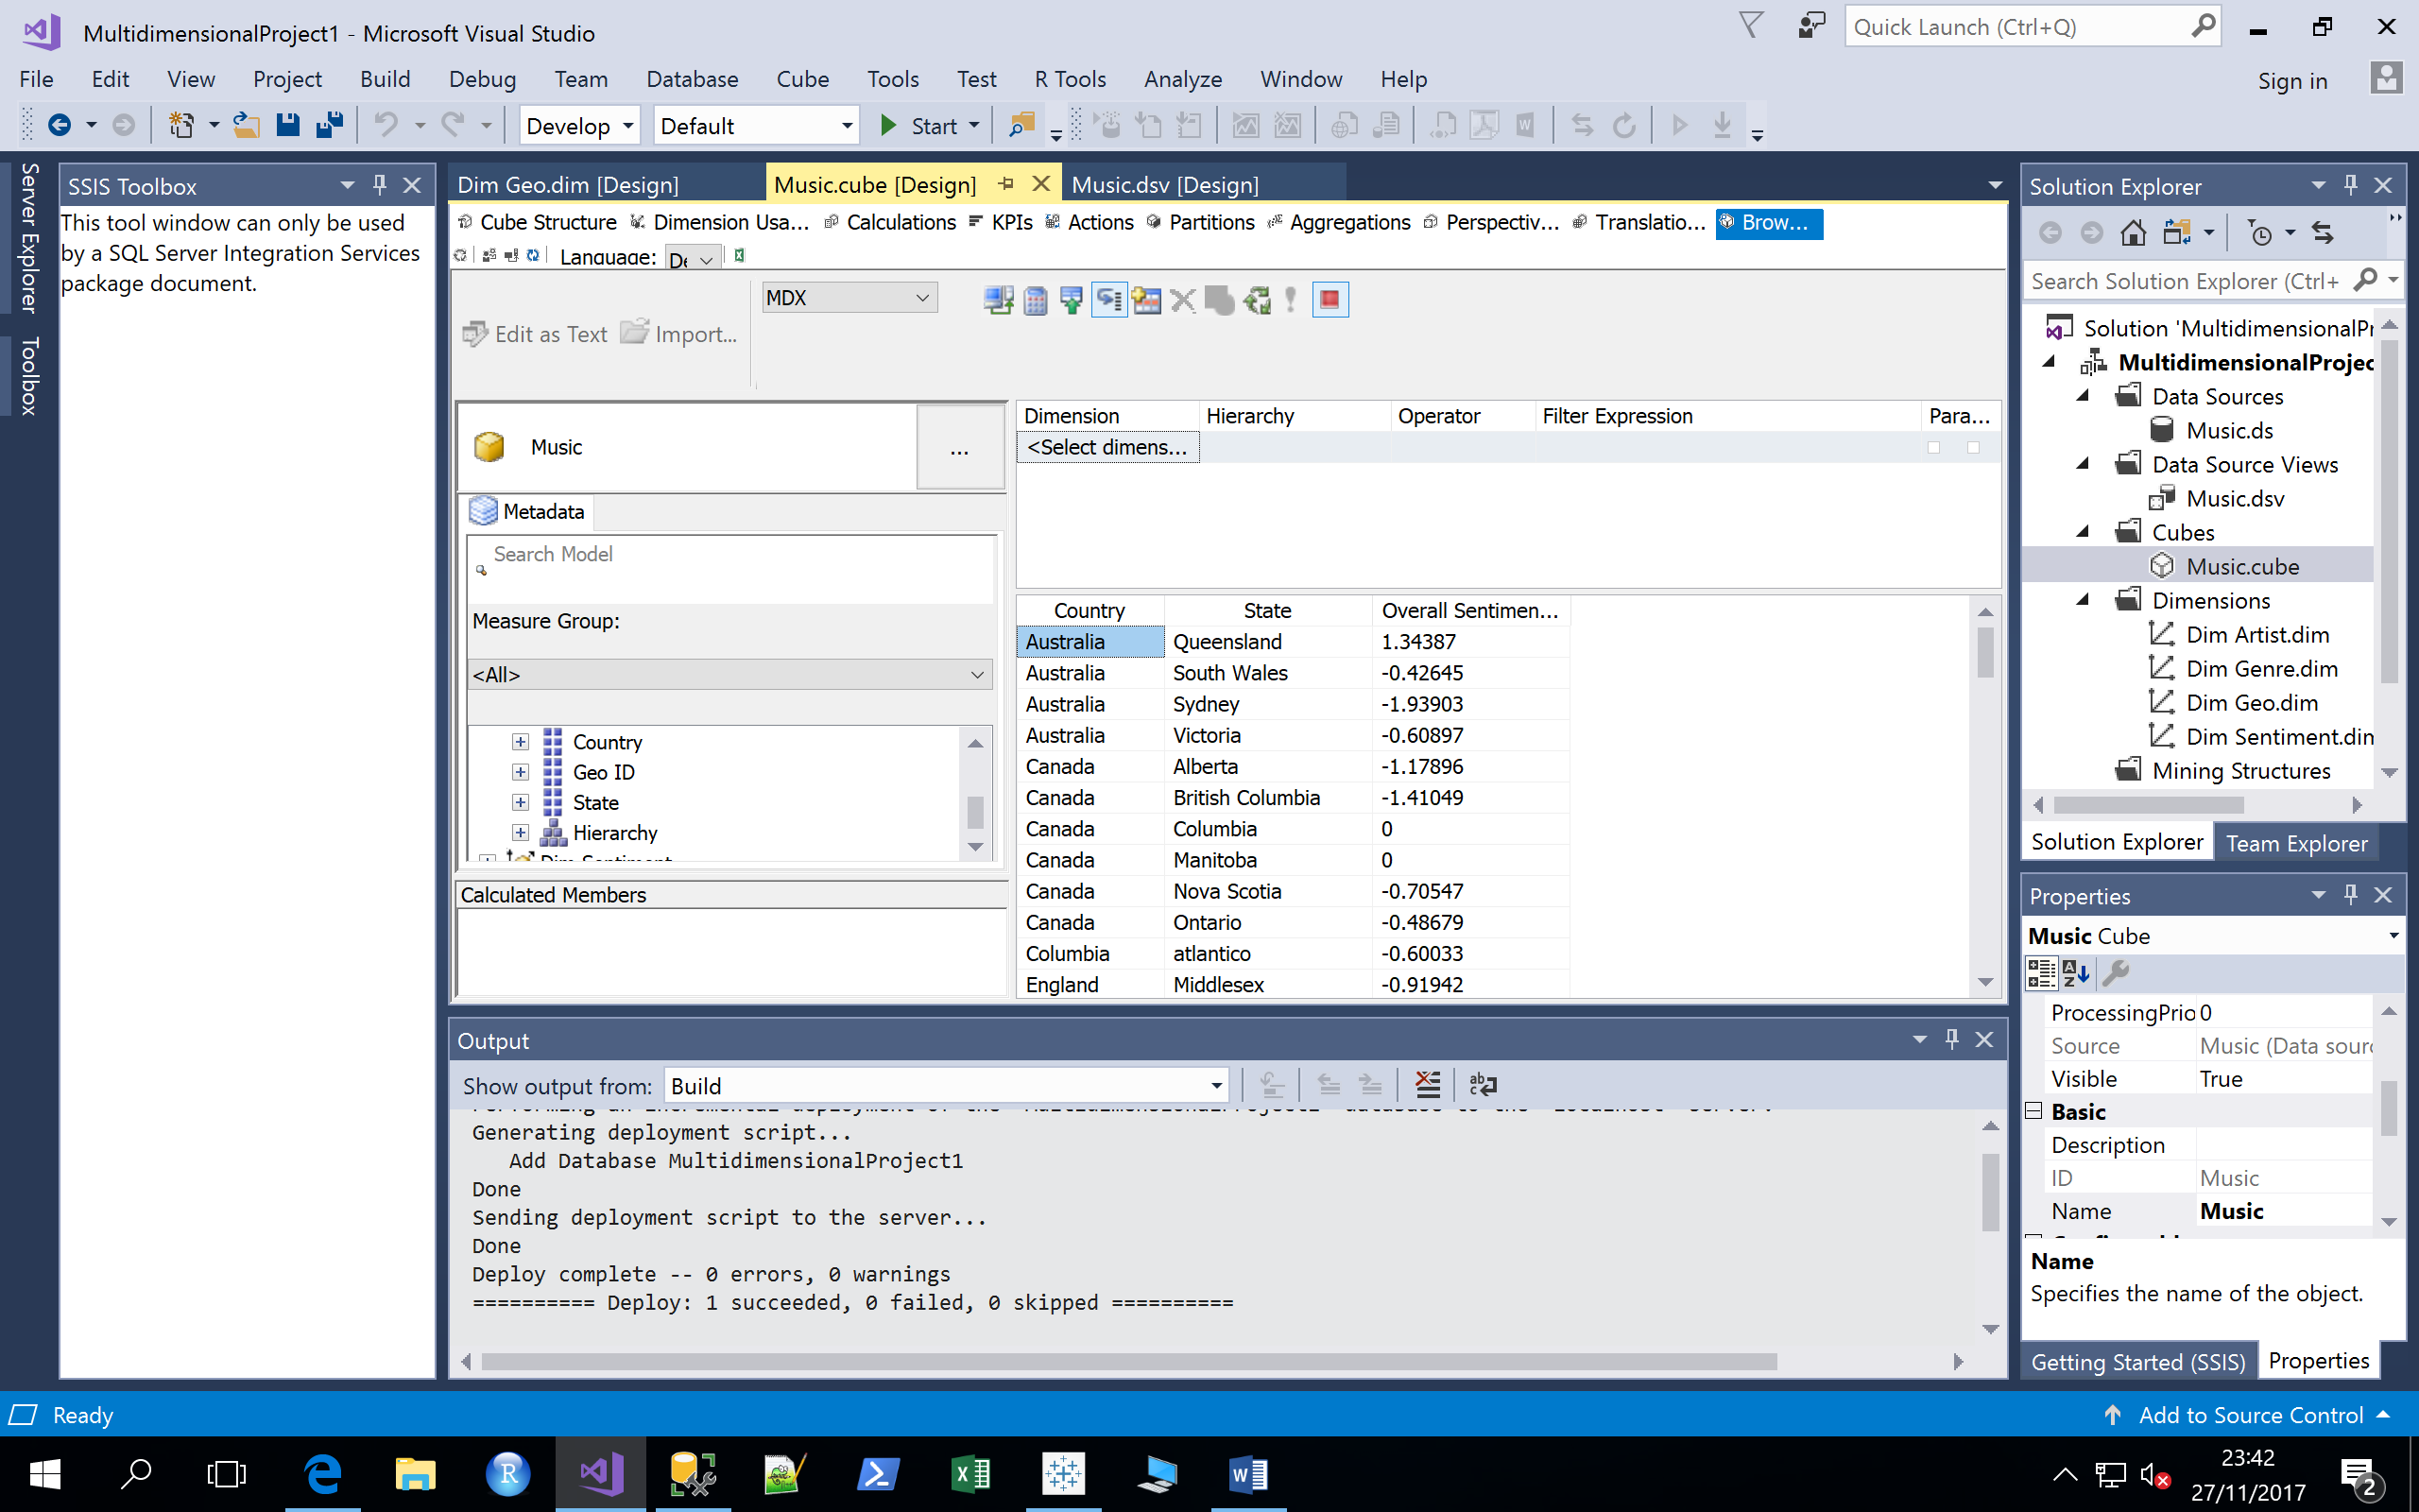
Check in the cube browser that it works
Process and redeploy the cube, then browse. You should be able to drag, measures from the fact table, and a Geo Hierarchy into the cube browser.
Click to execute the query, and you should see something like:

Slide 5
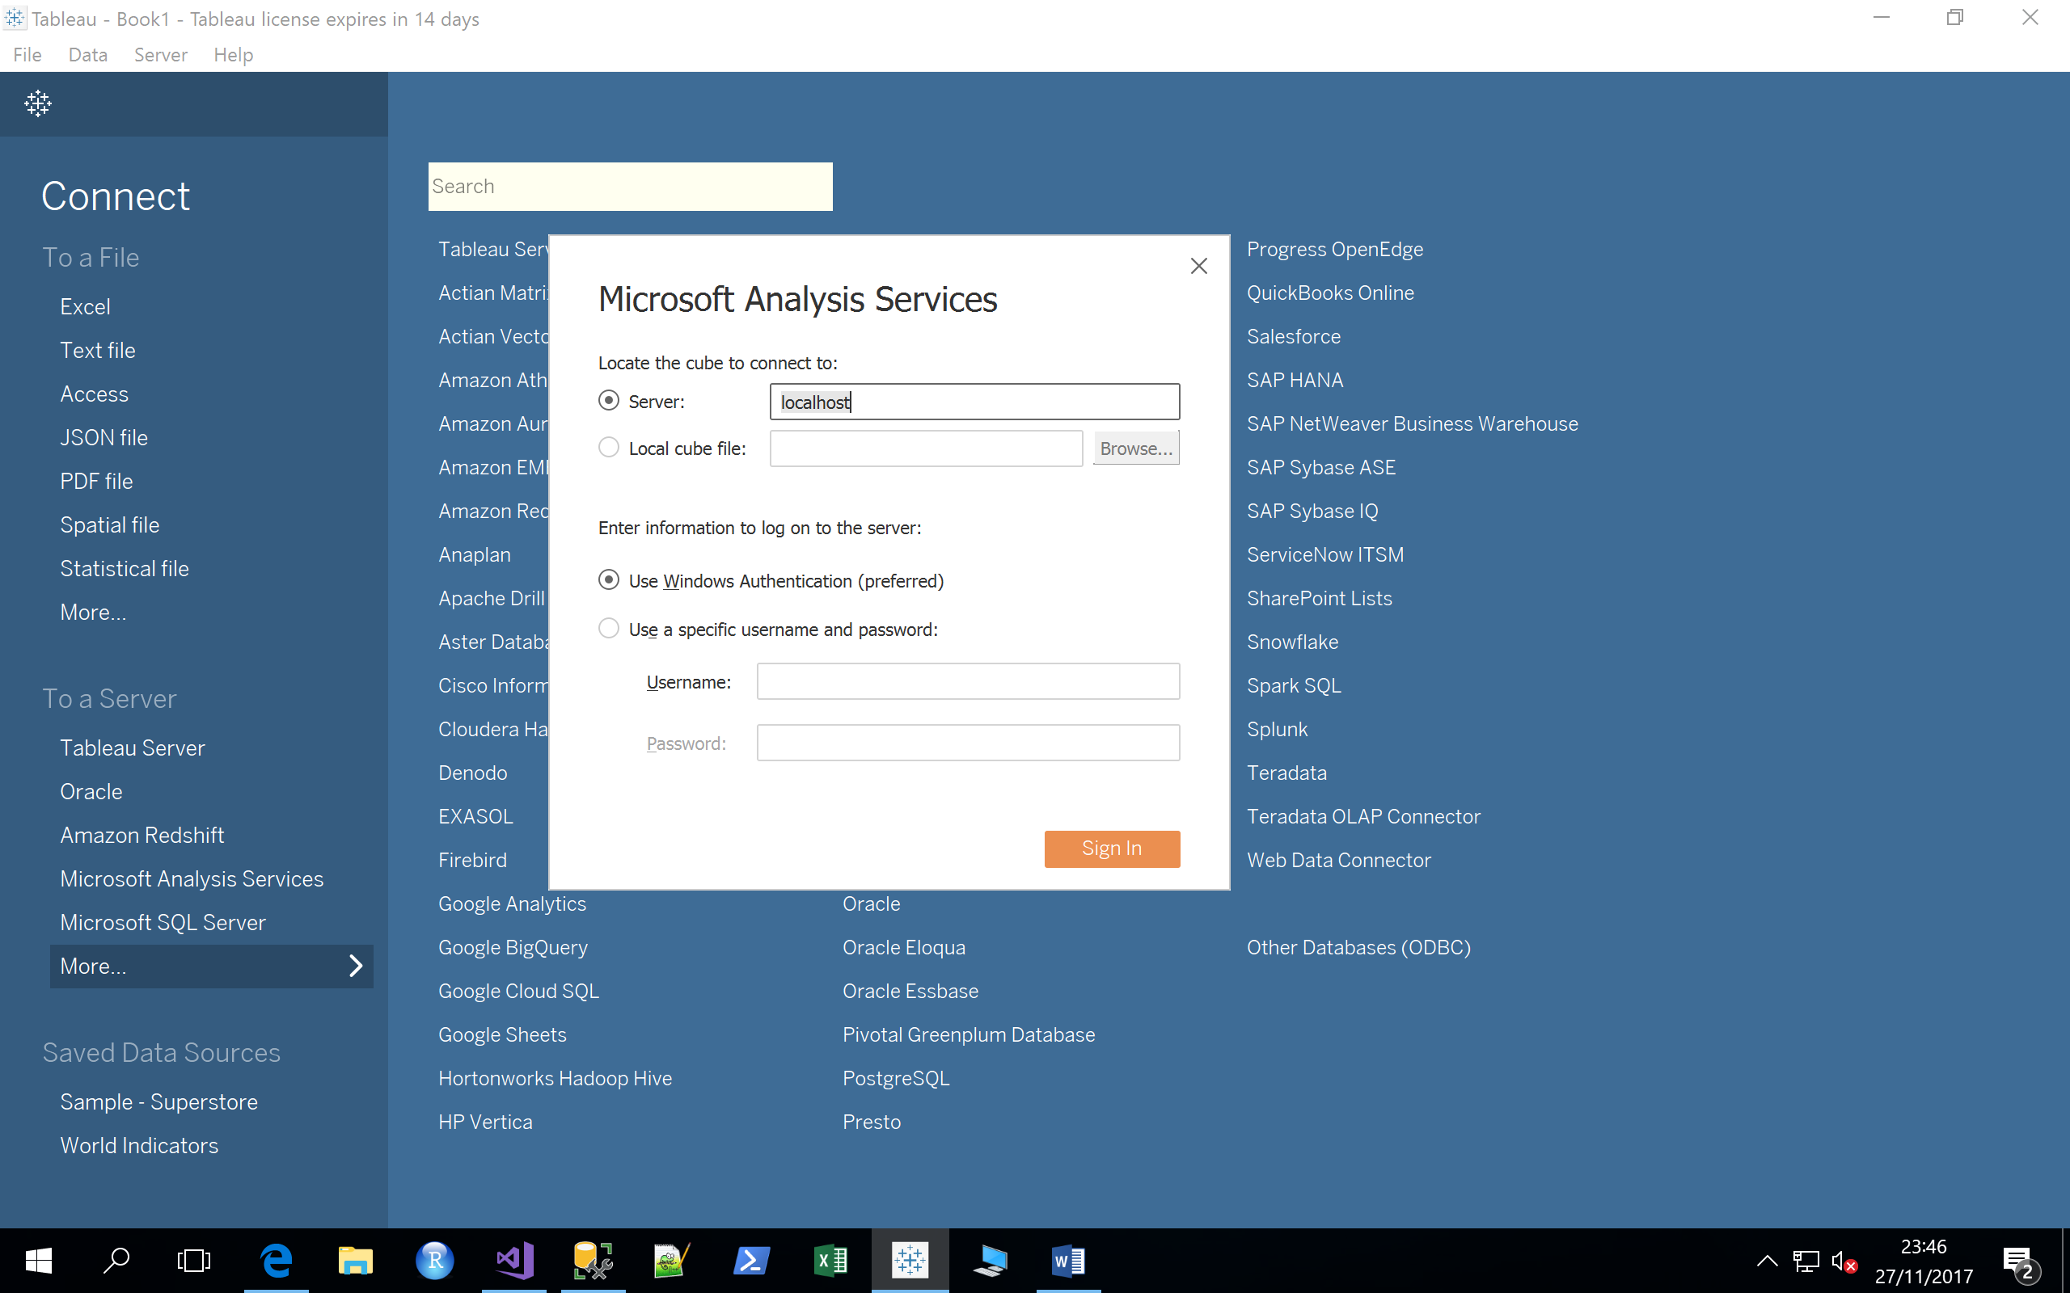
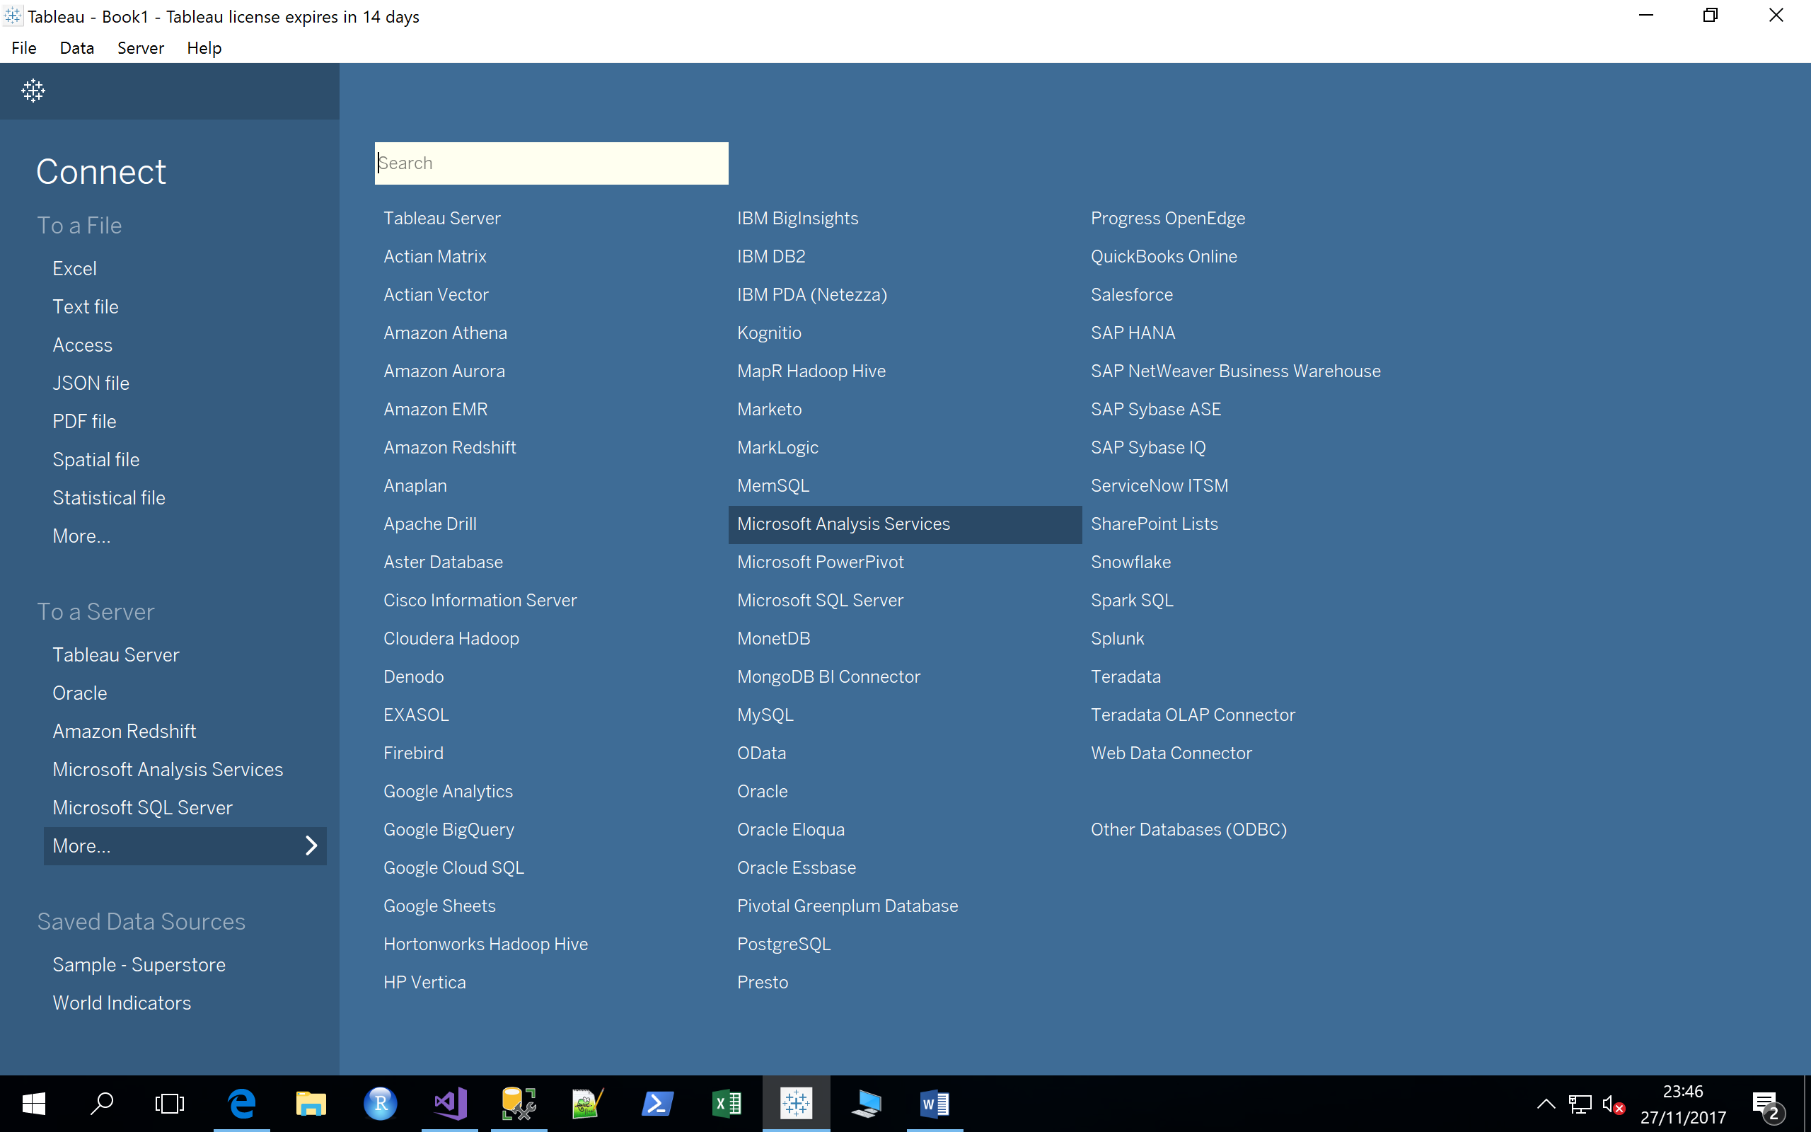
Now, over to Tableau
In the connect to a server menu, choose more, then Microsoft Analysis Services (once you’ve done this once it will appear as a frequently chosen option).
Then log into the server:
Finally, select your cube, and open the worksheet.

Slide 6
Now, over to Tableau
If you cube is designed for your BI queries, this part should now be quite easy:
Measures are the answers to your questions
Dimensions and their corresponding hierarchies are the context(s) of measures
For example, we could ask the question: which country has the highest overall sentiment score?
For this, we would need:
The overall sentiment score measure
The DImGeo dimension
Note, that Tableau can handle multiple measures projected across multiple dimensions.
Let’s construct the visualisation on the opening slide…

Slide 7
Building the Sentiment By Location Worksheet
Drag the Positive Score and Negative Score measures into the rows
Drag the DimGeo Hierarchy into the columns
If it’s not expanded, expand the “show me”, and choose the side-by-side graph type (3rd on the 3rd row)
The US data is disproportionally greater than the other countries, so edit the y-axis and choose a log scale
Collapse “Show me”
Lastly, expand the (click the +) country column.
Done
The Log scale makes it easier to consume the results and see differences between the countries.

Slide 8
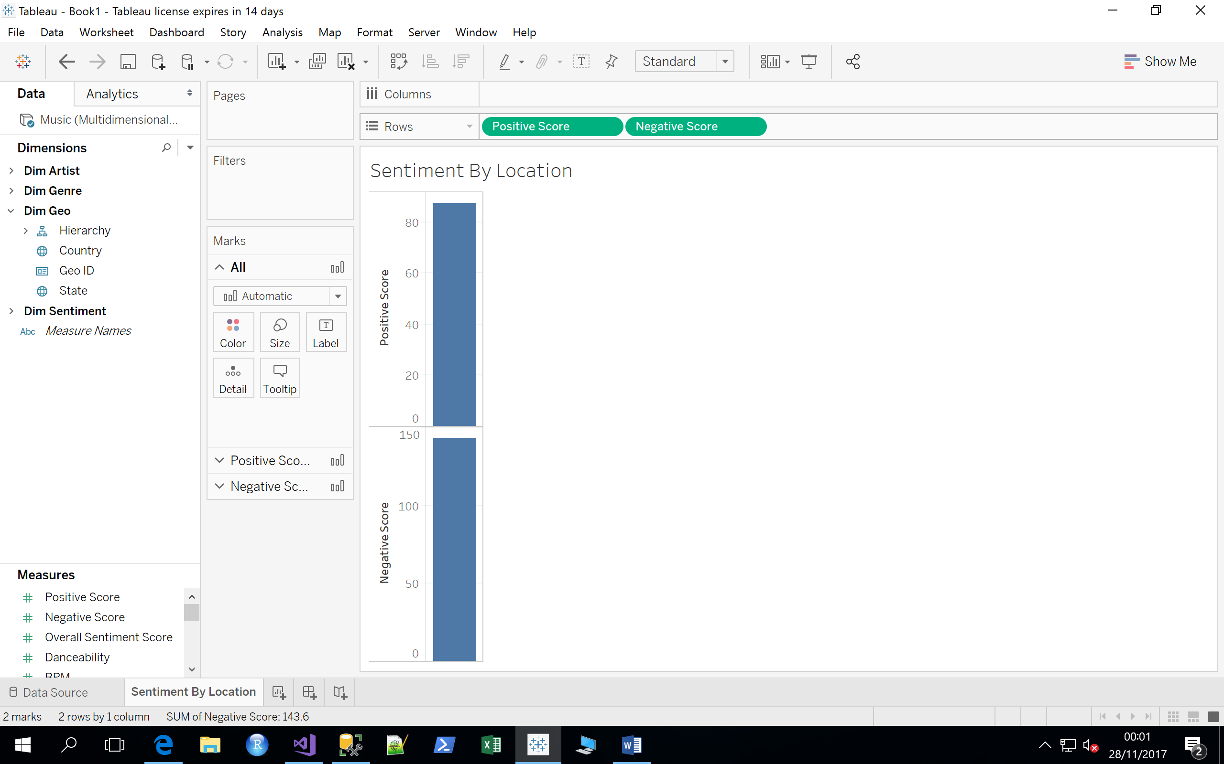
In screen shots…

Slide 9
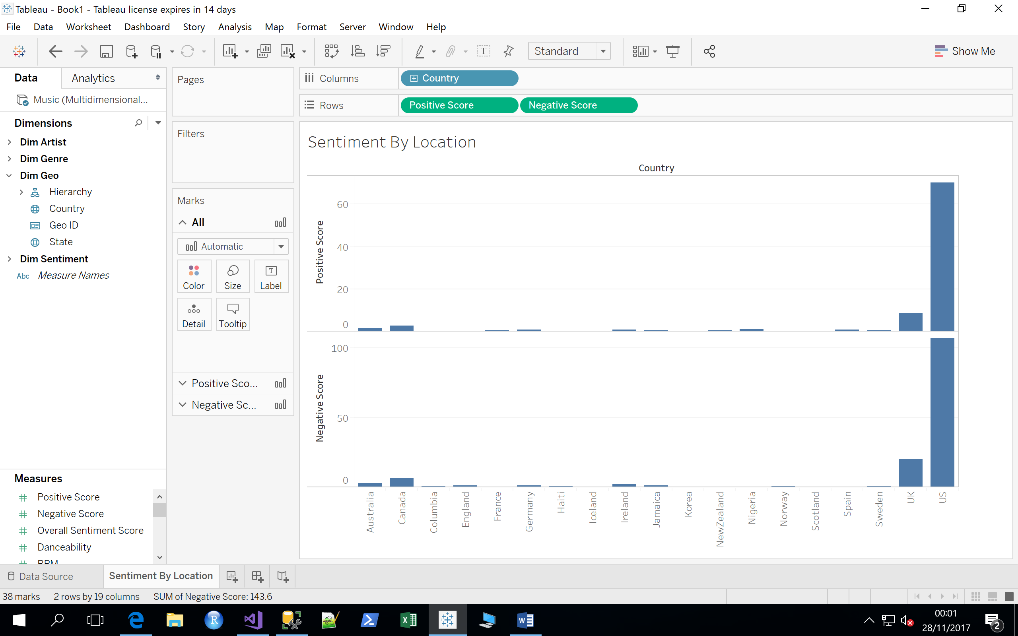
In screen shots…

Slide 10
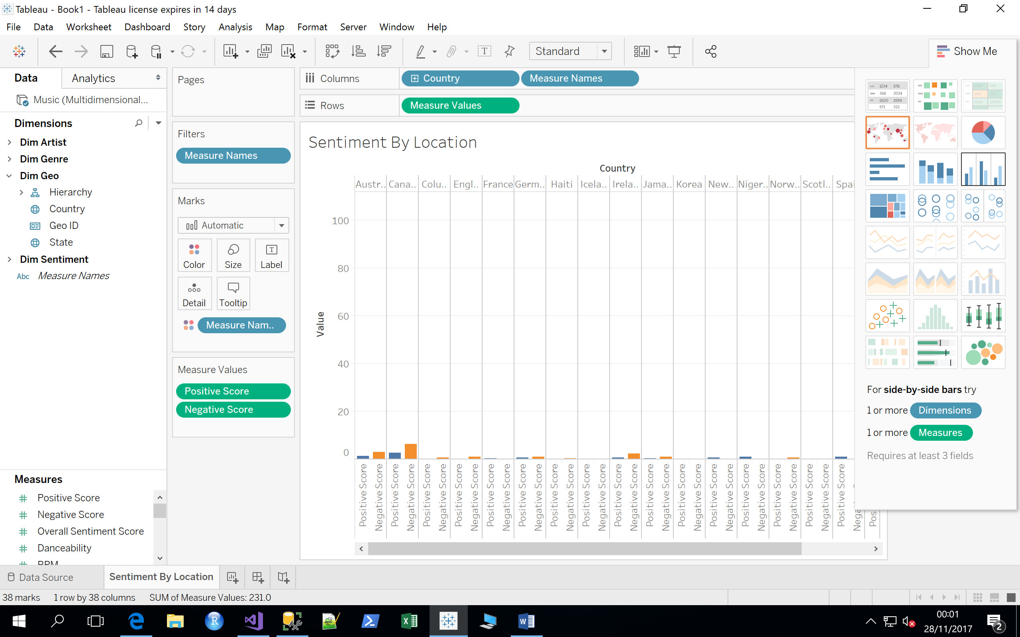
In screen shots…

Slide 11
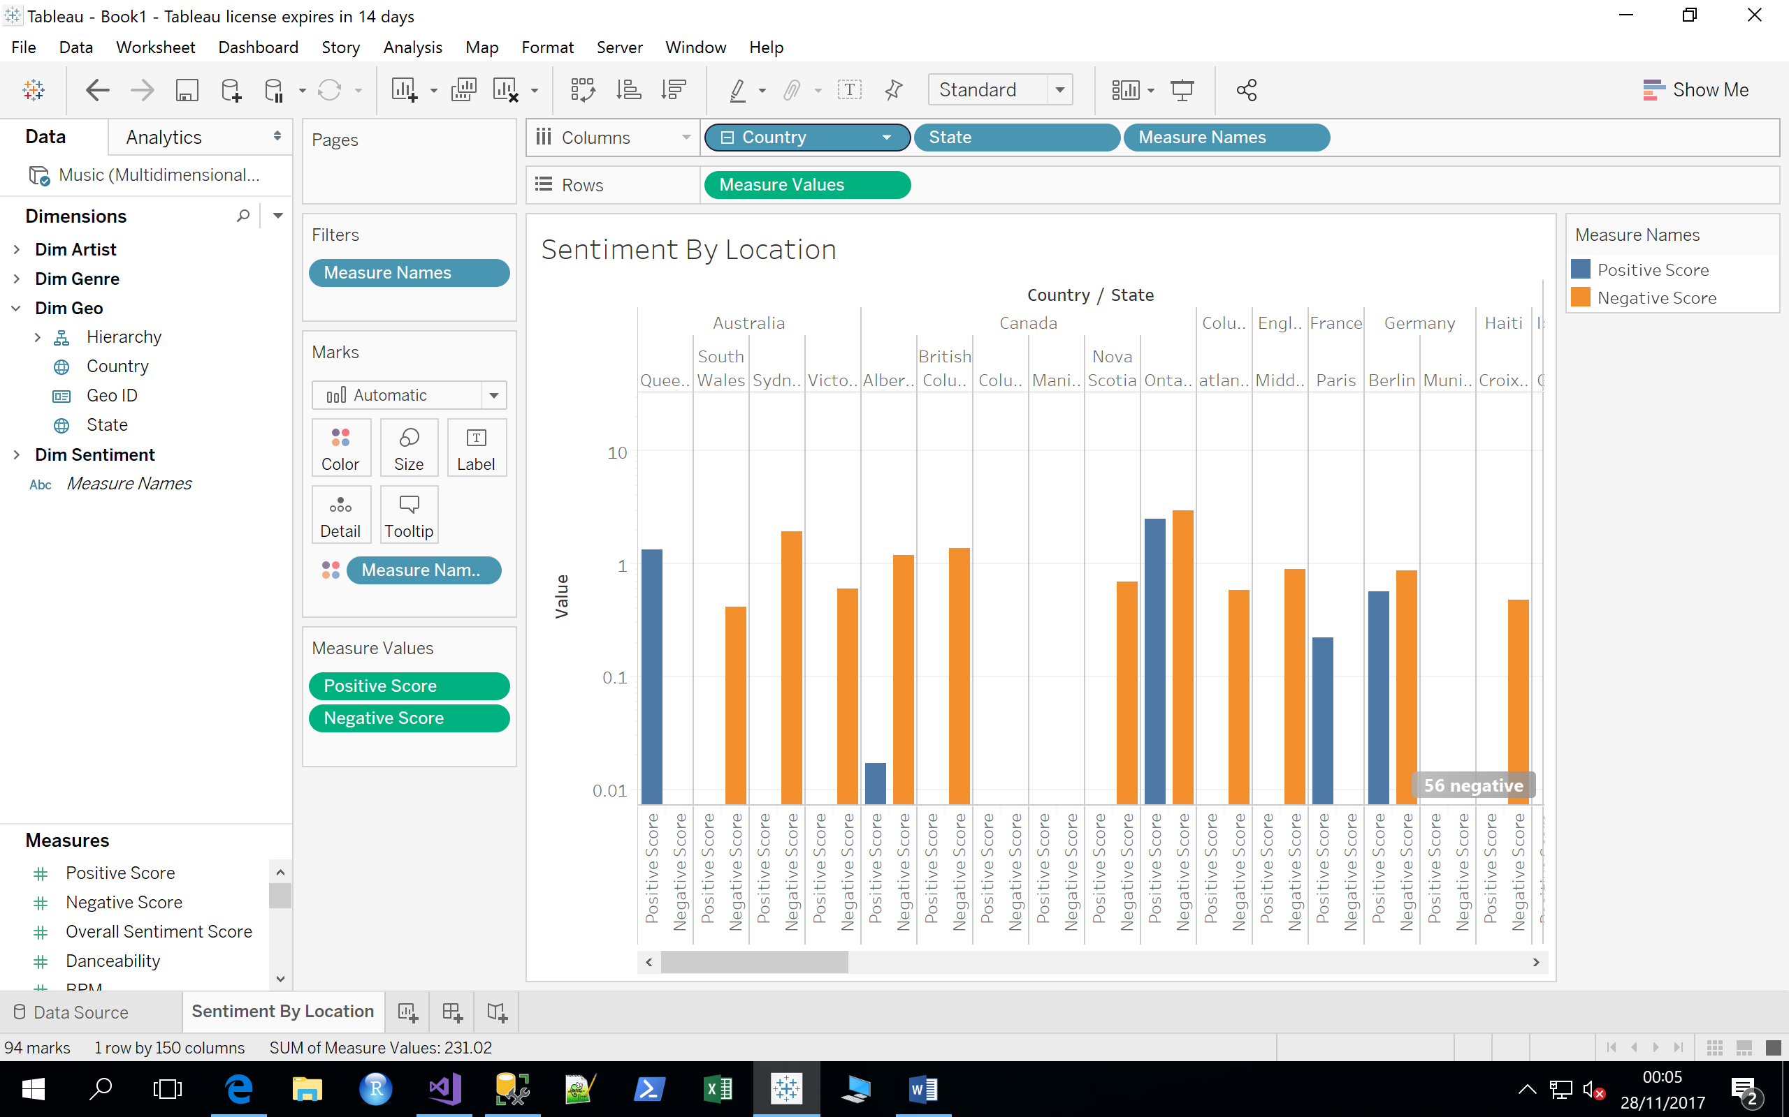
In screen shots…

